Slide 1

EASE – THE –ERROR 4.0
Problem Statement Title :Build a blockchain-based solution for intellectual property rights management, providing a secure and transparent platform for artists, creators, and innovators to protect and monetize their intellectual assets.
Team Name : dark knights
Team Leader Name : Sanjai solairaja
Theme Name : blockchain
College Name : sri Venkateswara college of engineering

Slide 2
Why This Problem Statement ?
The problem statement highlights the inefficiencies and vulnerabilities inherent in the current system of managing intellectual property rights (IPR). Here's why this problem statement is significant:
Time-consuming processes: Acquiring patents or copyrights involves lengthy bureaucratic procedures, delaying protection and monetization.
Legal disputes and backlog: Courts are burdened with pending IP cases, exacerbating resolution times.
Vulnerability to fraud: Current systems are susceptible to fraud, including false patents and tampered dates.
Unauthorized usage: Many exploit intellectual property without proper licensing, disrupting creators' rights and income.

Slide 3







Modules and Technology Stack
JS
SOLIDITY
METAMASK
HARDHAT
WEB3.JS
ETHERS.JS
PYTHON FLASK

Slide 4
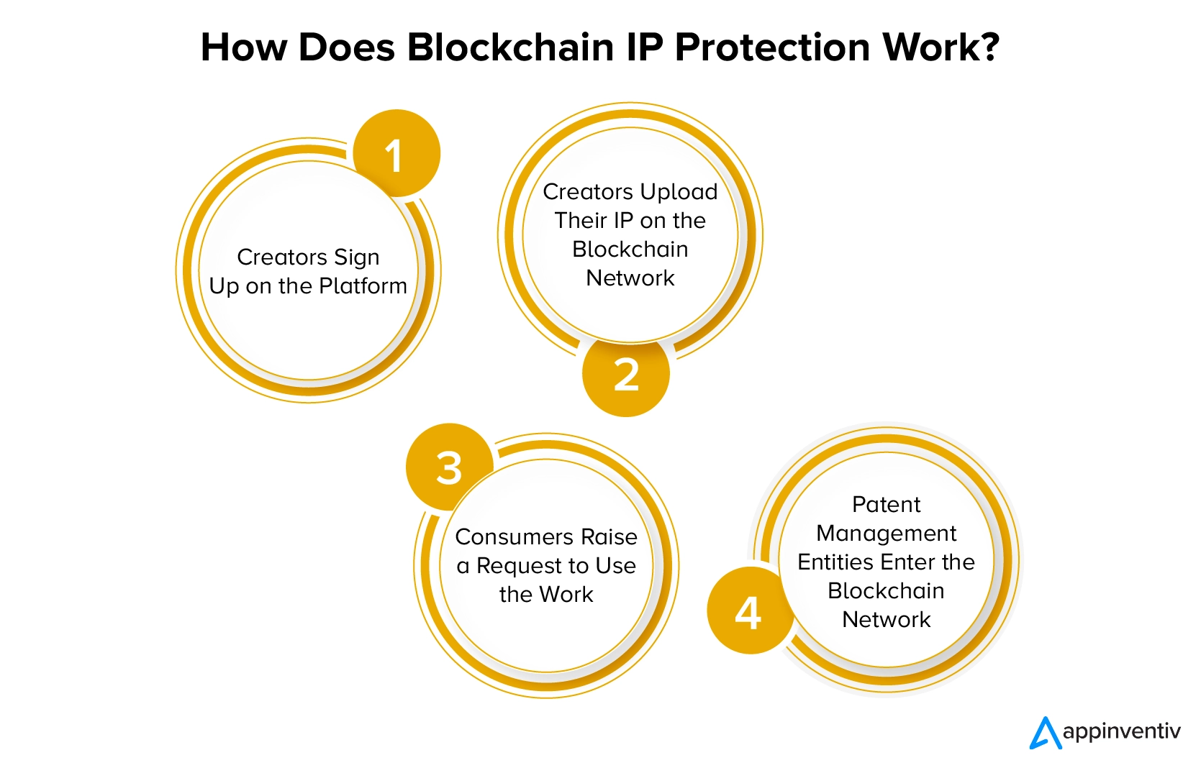
Work Flow

Slide 5
Use Cases and Benefits
Use Cases:
Immutable Proof of Ownership: By recording ownership and creation timestamps on the blockchain, creators establish immutable proof of ownership. This prevents tampering and provides irrefutable evidence in case of disputes or legal proceedings
Streamlined Licensing Process: Creators can use the blockchain platform to seamlessly acquire licenses for their intellectual assets. Smart contracts automate the licensing process, ensuring transparency and reducing administrative overhead.
Global Access to Intellectual Property Marketplace: The blockchain platform provides a decentralized marketplace for intellectual property rights, accessible globally. Creators can reach a wider audience of potential licensees, facilitating greater exposure and revenue generation.
Benefits:
Enhanced security: Blockchain's immutable ledger prevents tampering and fraud, ensuring the integrity of intellectual property rights.
Efficiency: Automated processes via smart contracts reduce administrative overhead, streamlining licensing, and royalty distribution.
Fair compensation: Seamless licensing flow guarantees timely and accurate payments, promoting fair compensation for creators.
Global accessibility: Decentralized marketplace expands opportunities for creators to reach a wider audience, fostering innovation and revenue growth on a global scale

Slide 6
Team Member Details
1.Name : Sanjay Kumar V
Class : 2nd year/EEE
Reg No.: 2127220601063
2.Name : Shrimathi G
Class : 2nd year/EEE
Reg No.: 2127220601070
3.Name : Surya Dev RG
Class : 2nd year/AI&DS
Reg No.: 2127220502102
4.Name : Madhuvansh S
Class : 2nd year/CS
Reg No.: 2127220501083
5.Name : Rahul TV
Class : 2nd year/IT
Reg No.: 2127220801068
6.Name : Sahithya R
Class : 2nd year/CS
Reg No.: 2127220501124

